Slide 1
49M11-843 SureSwitch™ Multi-Volt Contactor

Slide 2
Business and Product Overview
49M11-843 SureSwitch™ Multi-Volt Contactor

Slide 3
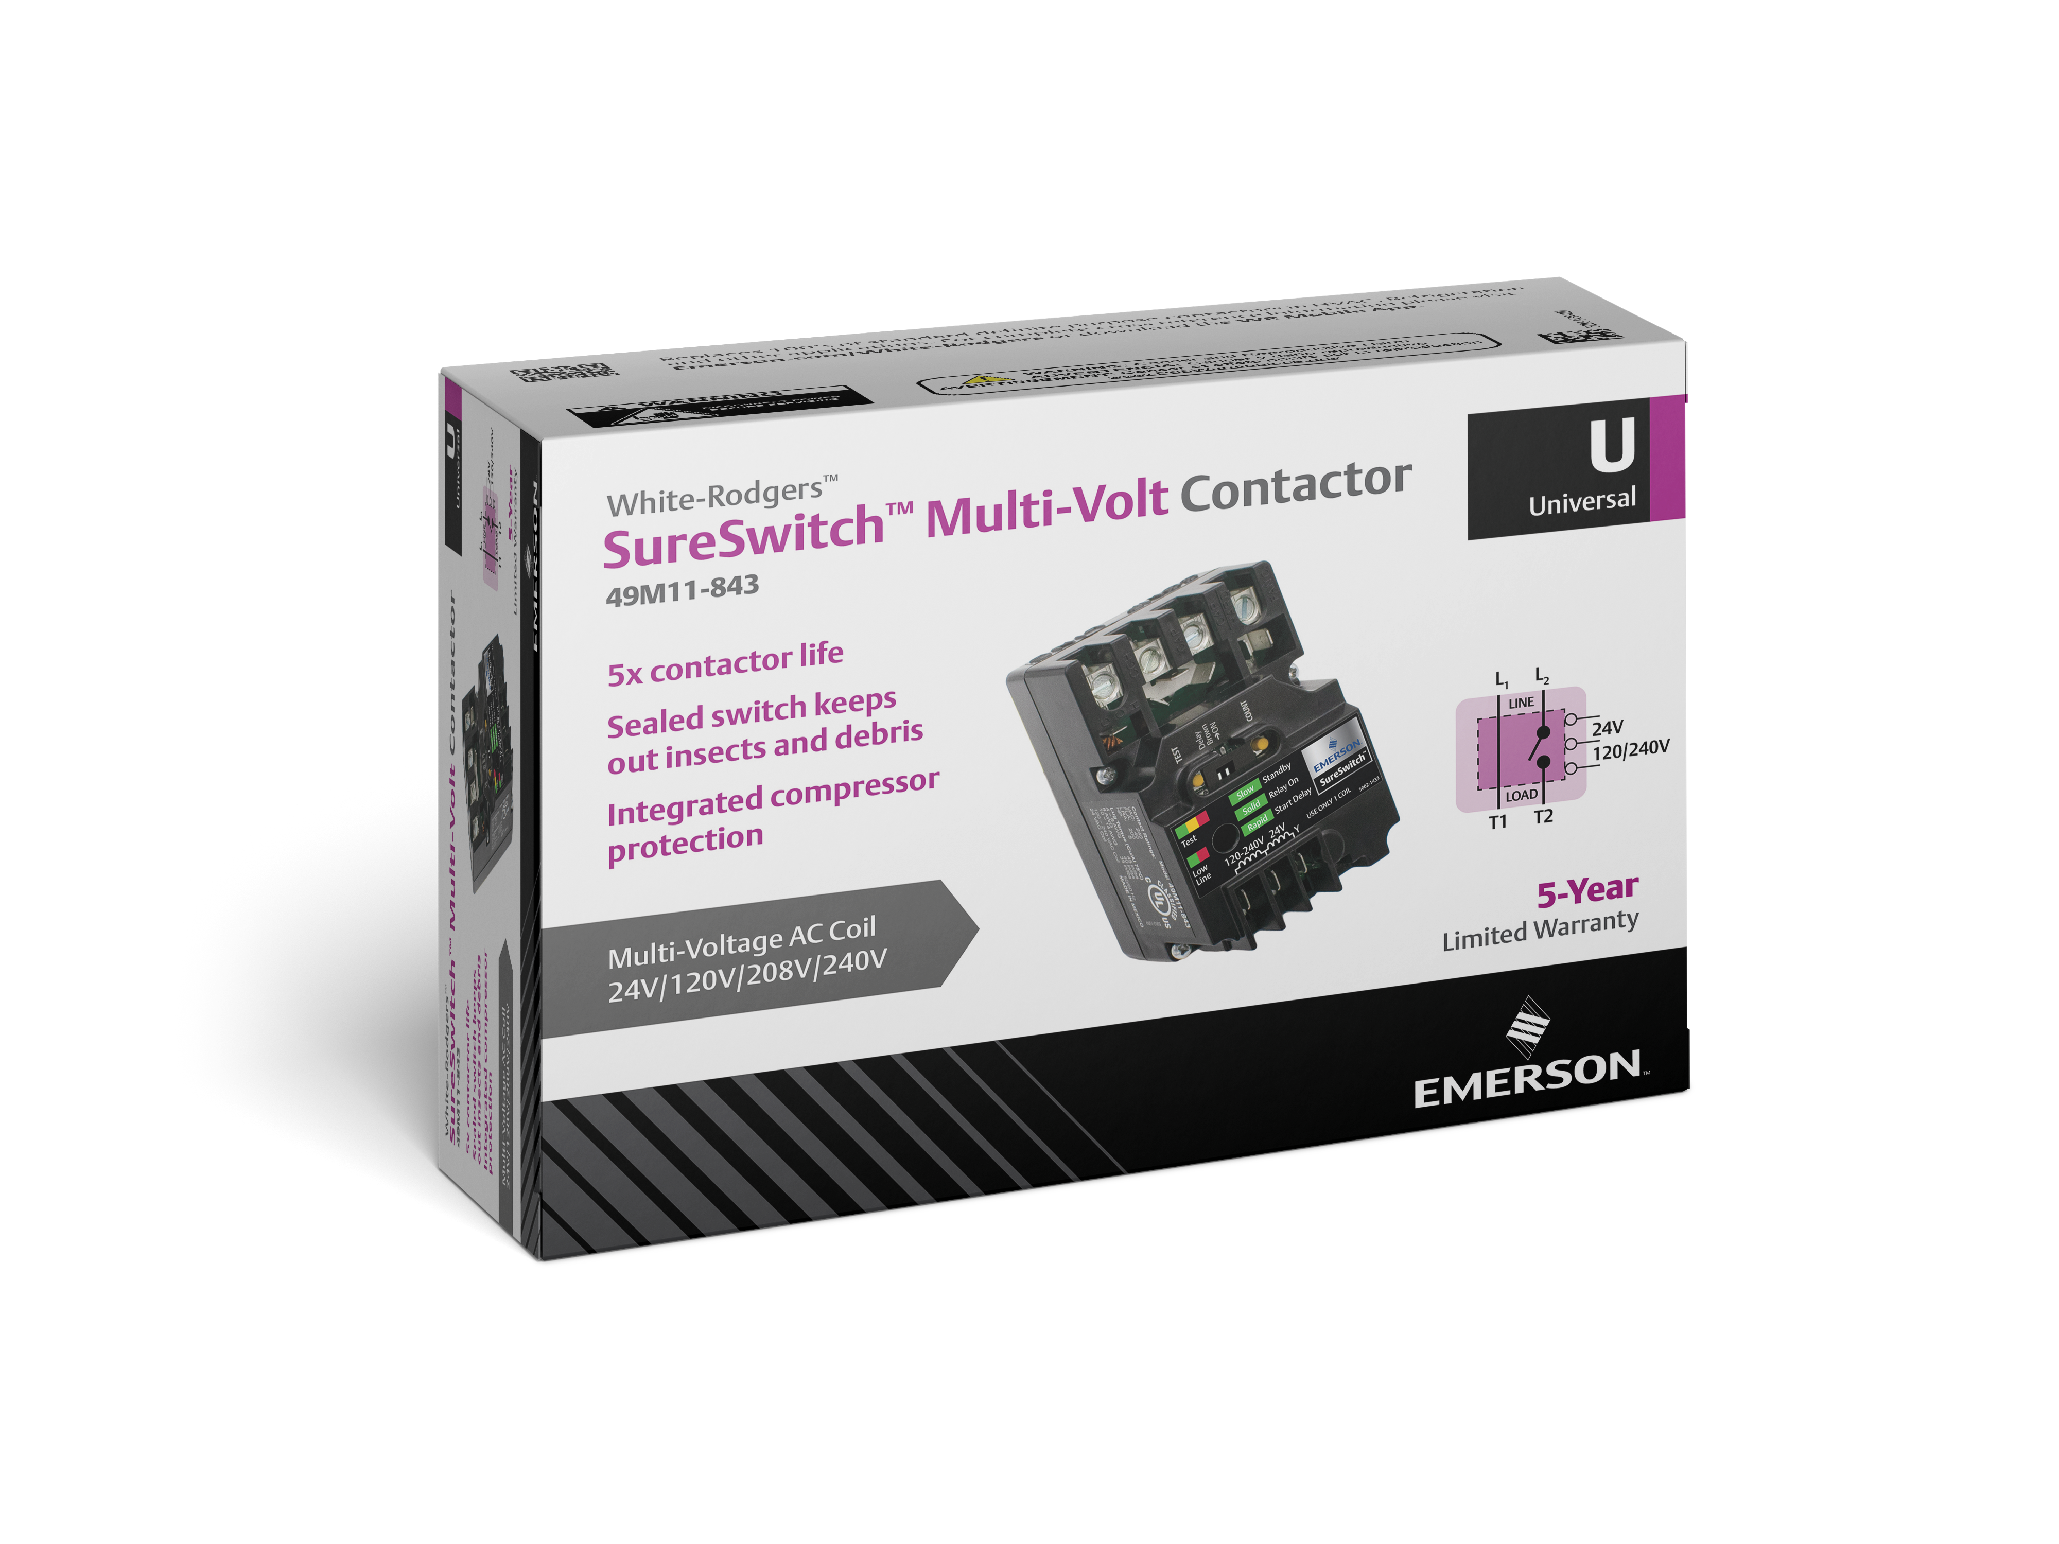
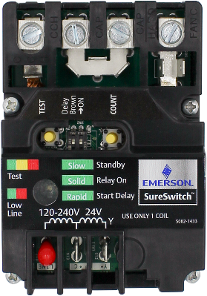
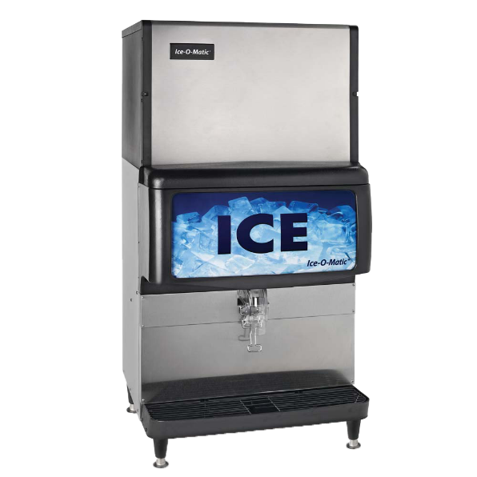
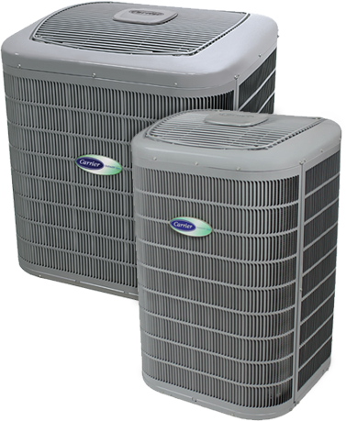
Introduction
The 49M11-843 SureSwitch™ Multi-Volt Contactor is the next generation single-phase contactor with a microprocessor brain that replaces 24v, 120v, 208v, or 240v coil contactors.
Microprocessor control nearly eliminates contact welding and pitting
Sealed to keep out insects and debris
Protects condensers from brownouts and short cycling
Compatible with single stage residential AC/Heat pumps with PSC fan motors.
Also compatible with refrigeration equipment such as walk-in coolers, refrigeration cases, ice machines, and carbonated beverage machines.

Slide 4
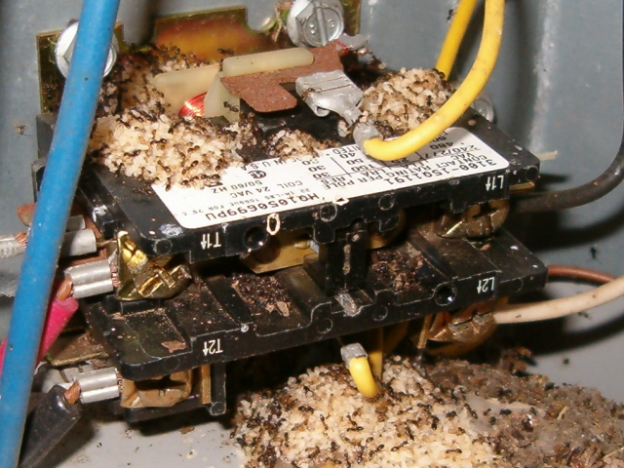
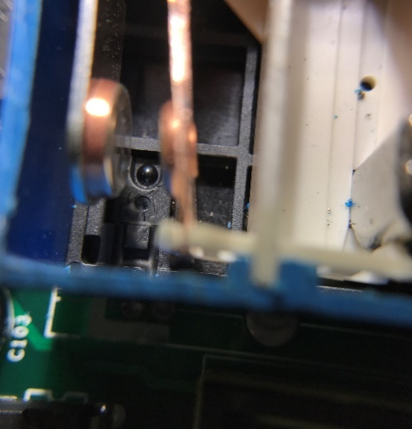
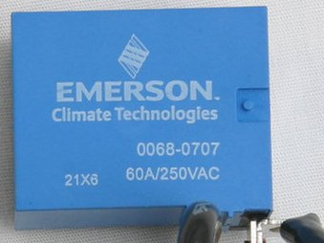
Additional Features and Benefits
  Microprocessor operates a short cycle and random startup timer
  Latching relay eliminates contactor chatter and hum
  Vibrant tri-color LED for operations check and troubleshooting
  Lifetime cycle counter for a fuller view into system life
  Compatible up to a 40 FLA rating / 5 Tons
  Coil terminals are separated with taller walls to prevent electrical shorts
Open design allows for damage from fire ants, other insects.
Optical sensor monitors the arc and adjusts timing.
Sealed to reduce damage from insects and debris.

Slide 5
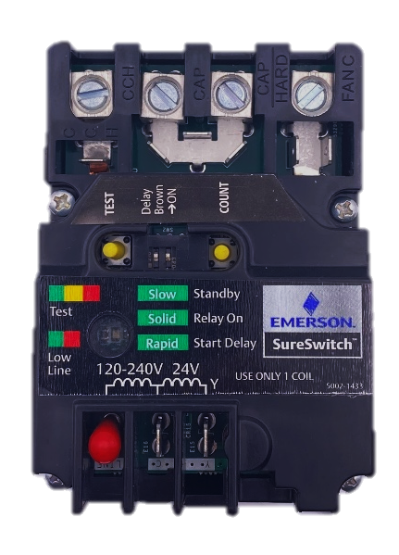
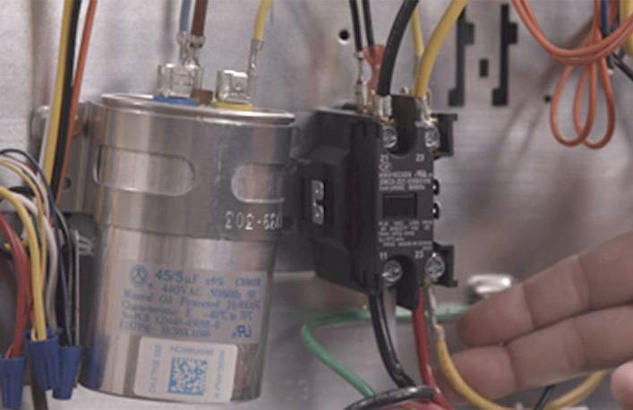
Why is It Better?
Increases system reliability and homeowner peace of mind.
5x Contactor life
5 Year warranty
Universal replacement
Replaces 287+ parts
Multi-Volt Contactor applicable to wider range of applications including AC, heat pump, refrigeration products with 24v, 120v, 208v, & 240v coils.

Slide 6
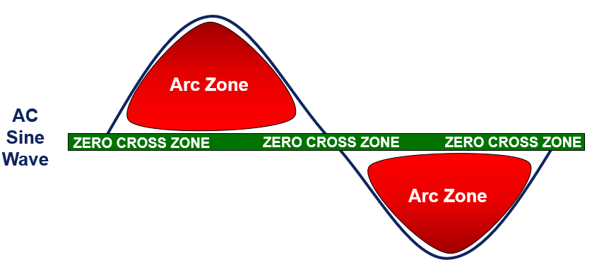
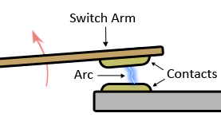
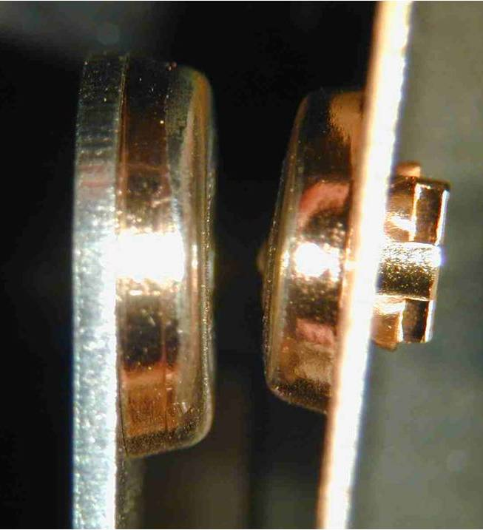
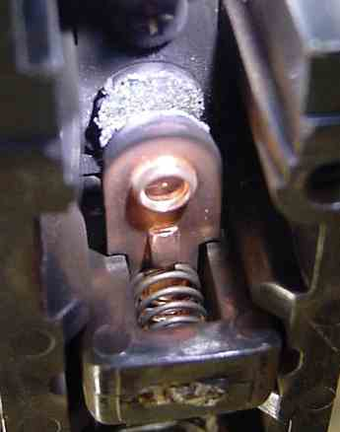
Microprocessor Extends Contactor Life
“Zero Cross” contact control switches without damaging current present.
SureSwitch™
Traditional Contactors
SureSwitch™ Sealed Relay with Optical Sensor plus unique opening and closing algorithms achieve consistent Zero Cross Switching. Contact shows no damage after 1M cycles.
Traditional contactors do not have microprocessor intelligence. They open and close at random, often in the “Arc Zone where damage occurs. Damage shown after 300K cycles.

Slide 7
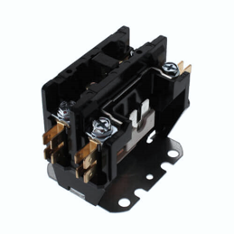
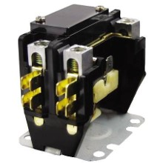
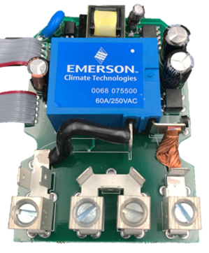
Competitive Comparison
Other “sealed contactors” do not offer protection against insect intrusion.
“Arc Cover,” “Dust Cover,” or “Plastic Noise Shields” do not offer the same level of protection as the fully sealed SureSwitch™.
Our contactor housing design limits dust and other contaminants from the magnet structure, reducing noise, eliminating insects, and reducing contactor failure.
No protection.
Some protection but some ants still get in.
Completely sealed
from insects and debris.

Slide 8

Testimonials
“The SureSwitch, which I installed myself, has actually made my old system run smoother and quieter, it starts up more gentle, and it keeps the bugs from frying it since it's sealed (an issue I've had more than once).”
-Peter
“They seem to me they are superior than a traditional contactor...I was a skeptic at first but I have them on several 10seer 5ton units that would burn up these crappy contactors we have. So far they have held up 2.5 years on my test units.”
-Joe Schearer
“Before I bought this I was replacing my contactor relay at least once a year. It's been 2 years since I installed this and so far so good. It really does start a/c quieter overall.”
-J Shea

Slide 9





WR Mobile App
Always up-to-date and easy to use:
Mobile App
White-Rodgers Website
Your resource for:
Product information and spec sheets
Complete Cross Reference
OEM compatibility
Installation information and videos
Wiring diagrams
Download:
Go to your app store
Type in WR Mobile
Install the app
OR
Open your camera
Hold it over the QR code
Tap “Open” on the
pop-down
Install the app

Slide 10
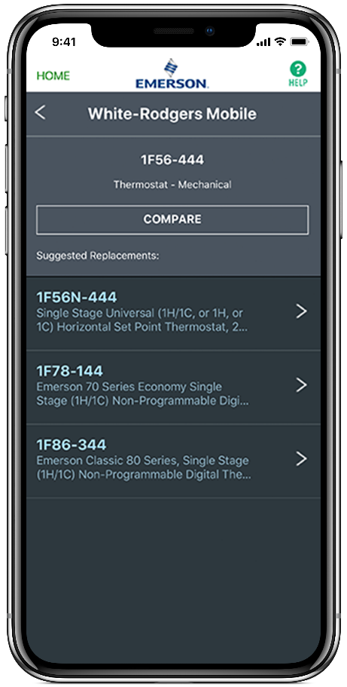
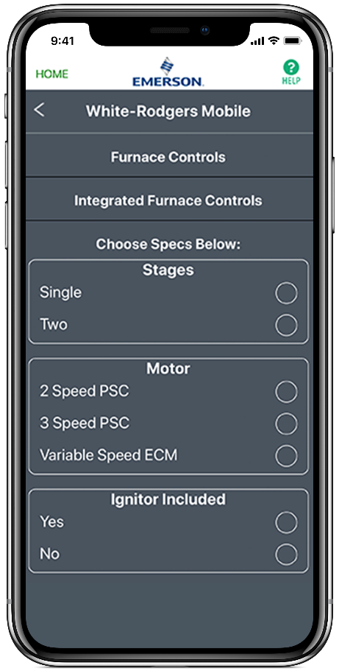
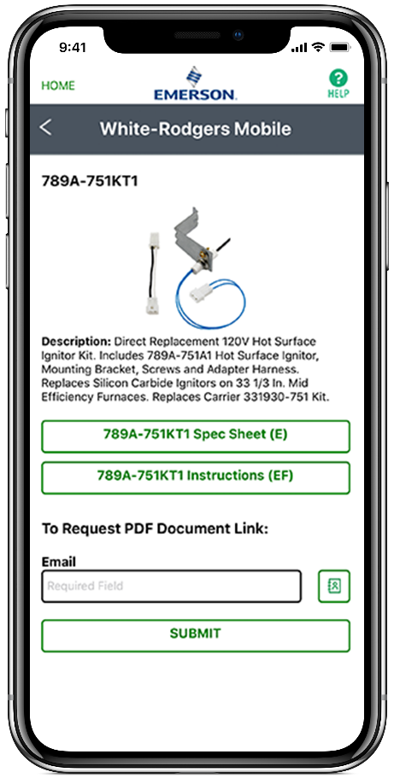
WR Mobile App
Easy to use!
Search by OEM, Competitive, or White-Rodgers Model Number
Product Number
Scrollable Product List
WR Replacement

Slide 11

White-Rodgers Cross Reference
Go to: www.whiterodgers.com
Hover over Tools & Resources
Click on: White-Rodgers Cross Reference/Product Information
Enter the Model Number or click on: Search Replacement Heating Controls by Major OEM Brand

Slide 12

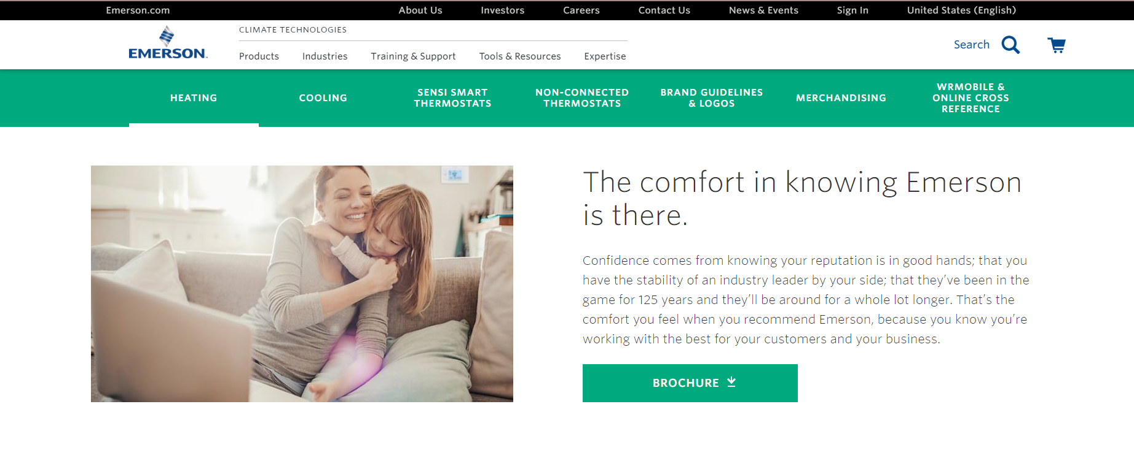
Wholesale Resource Site
Access useful resources to grow your business.
Visit: https://climate.emerson.com/en-us/brands/white-rodgers/white-rodgers-wholesaler-resource-center
You’ll find videos, stocking lists and product launch information for the following product families:
Heating Controls
Cooling Controls
Sensi Smart™ Thermostats
Traditional Thermostats
Contractor Rewards
Product Merchandising

Slide 13
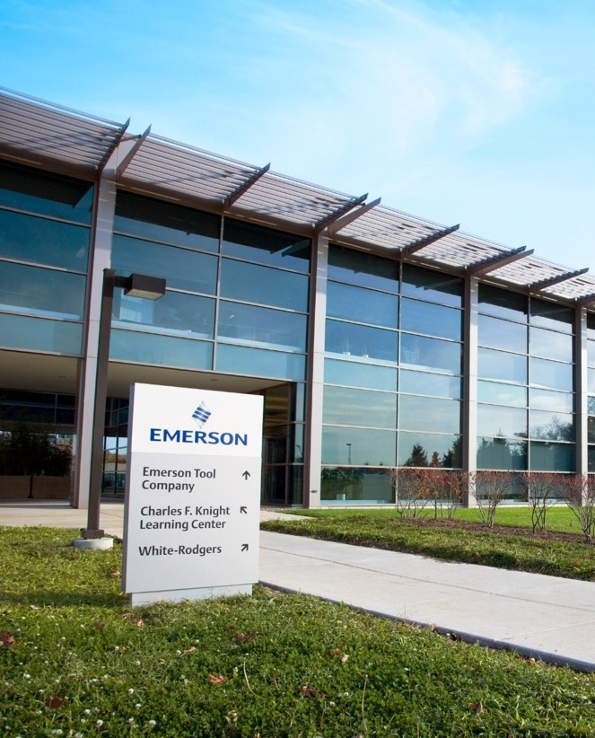
Why Contractors Trust White-Rodgers
Industry Leading Products
Used by more OEM’s
Offering the widest range of Universal Replacement Controls
Ease of Installation
Simple, easy to understand instructions
Product Reliability
Quality Control assures reliable products
Affordable
Competitive pricing
Supported by Knowledgeable Representatives
Contractor direct phone support

Slide 14
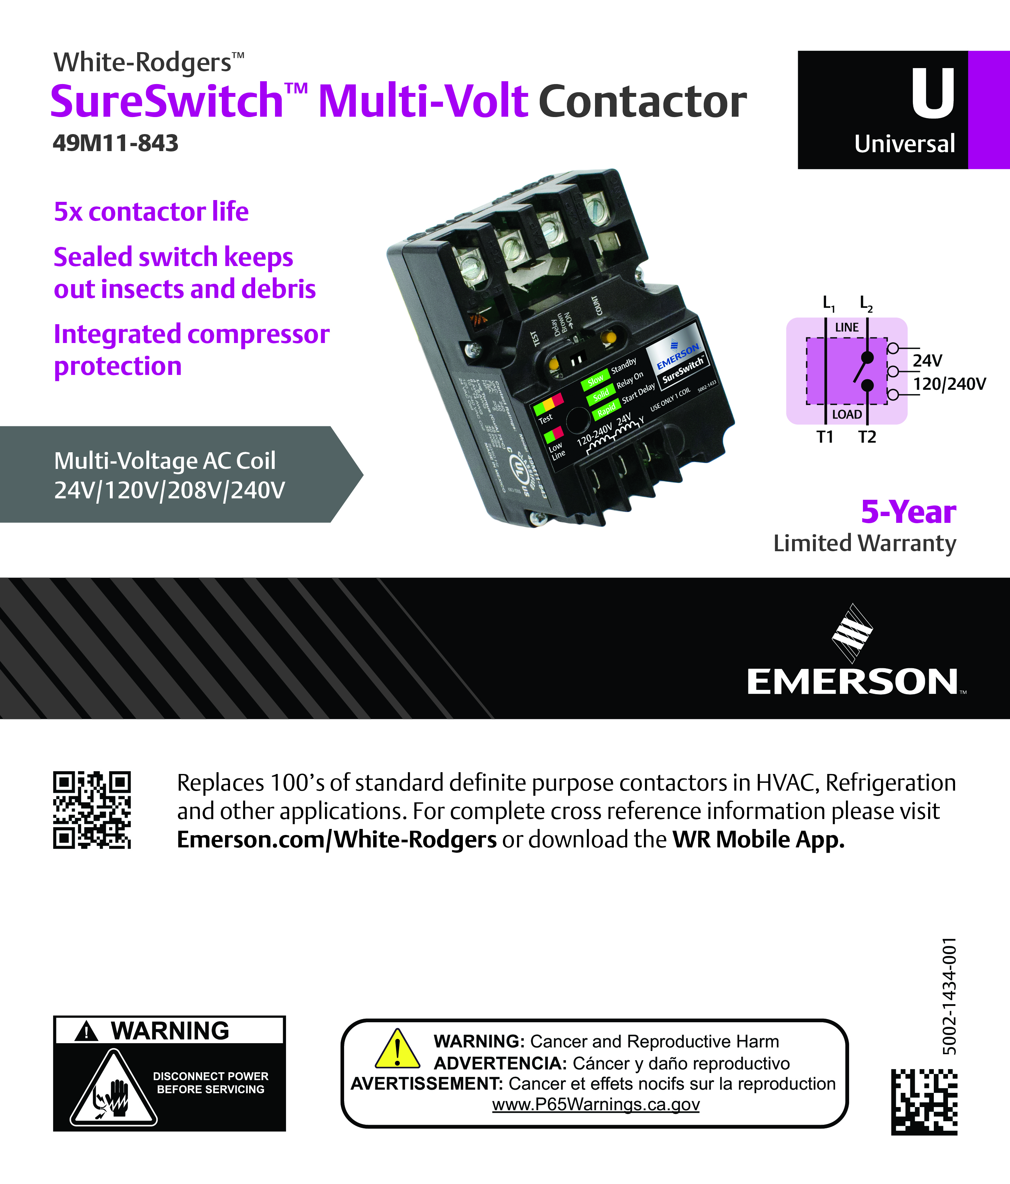
Customer Driven Packaging
1
2
1. Universal or Direct OEM
2. Product Type & Color Code
  Red = Indoor Units
  Purple = Outdoor Units
  Gold = Commercial
3. Model Number
4. Large Product Image(s)
5. Key Attributes
  Stages
  Blower Motor Type
  Ignitor Voltage
  Other
6. Cross Reference on box
3
4
5
6

Slide 15
Technical
49M11-843 SureSwitch™ Multi-Volt Contactor

Slide 16
Introduction
The 49M11-843 SureSwitch™ Multi-Volt Contactor is the next generation contactor with a microprocessor brain that replaces 24v, 120v, 208v, or 240v coil contactors.
Microprocessor control nearly eliminates contact welding and pitting
Sealed to keep out insects and debris
Protects condensers from brownouts and short cycling
Compatible with single stage residential AC/Heat pumps with PSC fan motors.
Also compatible with refrigeration equipment such as walk-in coolers, refrigeration cases, ice machines, and carbonated beverage machines.

Slide 17
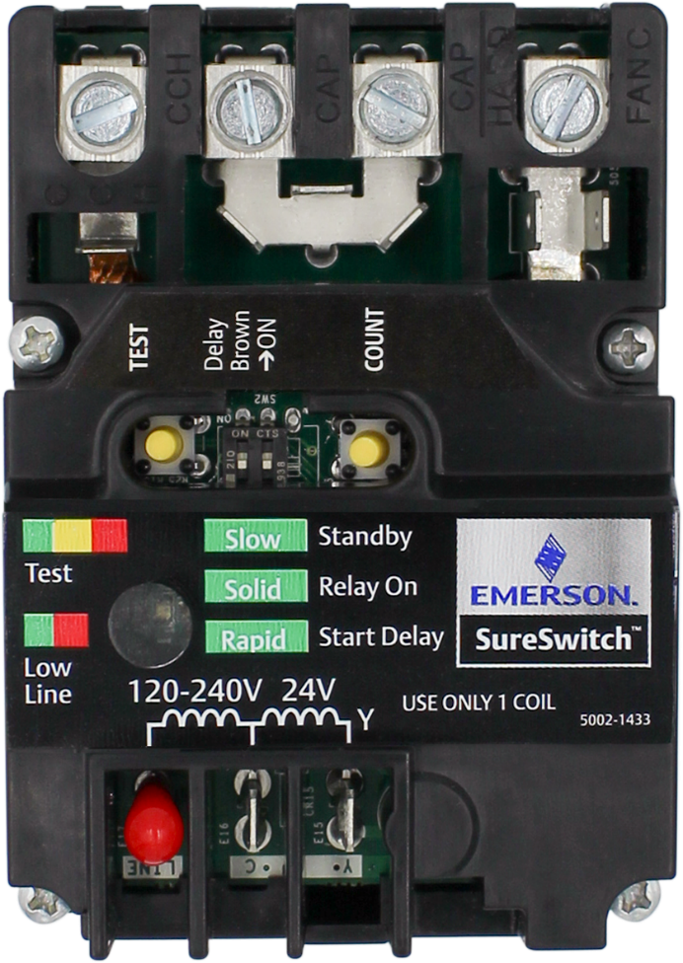
49M11-843 SureSwitch™ Multi-Volt Contactor Features
Features:
Line voltage Brownout Protection
Test Button to simulate a 5 sec “Y” call
Short Cycle Protection Delay Switch
  - Factory set to on (3 minutes)
Lifetime Cycle count Button
Brown Out Protection Switch
  - Factory set to on (180v >4sec.)
Tricolor LED Fault/Status Indicator
24v/120v/240v Coils
Random Start Delay following Brownout (5-90sec.) (Not Pictured)
Sealed Contacts (Not Pictured)
1
2
4
3
5
6
8
7
49M11-843

Slide 18
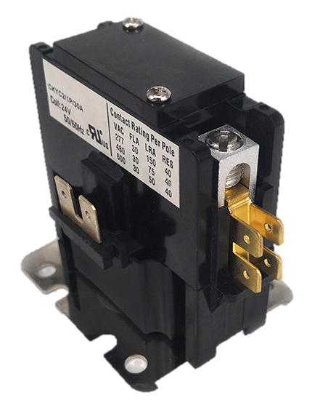
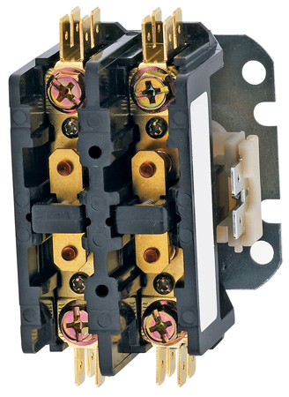
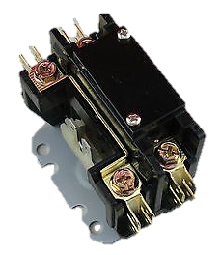
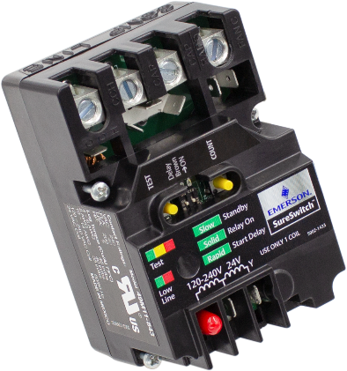
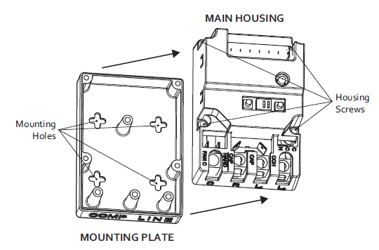
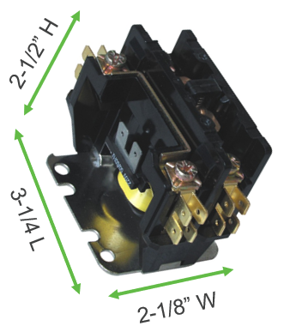
Easy Replacement
SureSwitch replaces 1, 1.5, or 2 pole contactors with the identical mounting footprint.
2-3/8” H
SureSwitch
3-7/8” L
Four-hole mounting pattern matches industry standard contactors.
2-3/4” W
Typical
Contactor

Slide 19
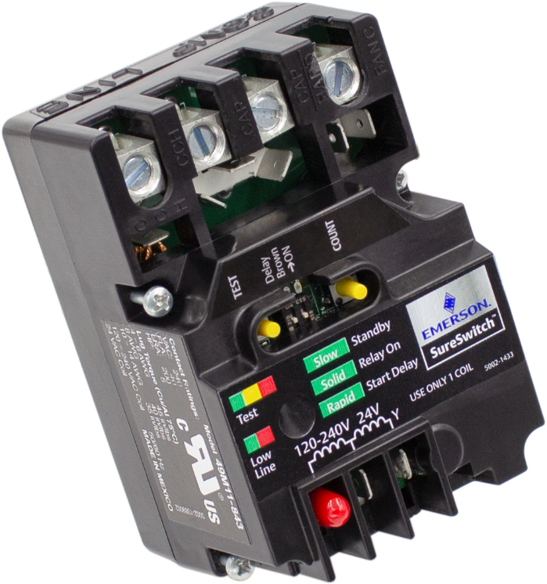
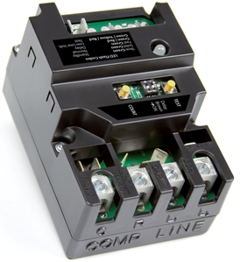
Product Improvements of the
49M11-843 SureSwitch™ Multi-Volt Contactor
Coil voltage options of 24v, 120v, 208v,& 240v
  Refrigeration Compatible
  Red cap on 120/240v coil terminal
Removable Label to identify Switched and Non-Switched legs.
Brighter LED
  Higher visibility reading
Taller Dividers between Coil Spades
49M11-843
49P11-843

Slide 20

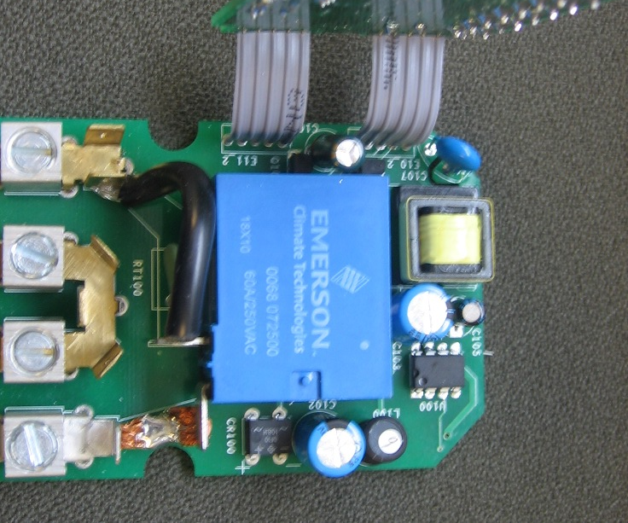
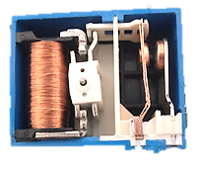
Feature and Design
SureSwitch™ inside view two panel design
Stacked circuit board design helps keep product
dimensions as compact as possible
User interface/coil board
Power supply
High voltage bottom PCB
Sealed relay switches compressor & fan loads
2
Product Benefit/Feature
3
1
4
Inside the sealed relay box.

Slide 21
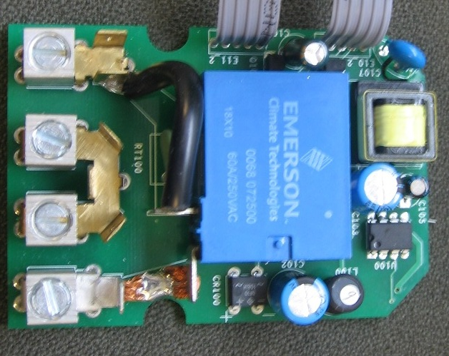
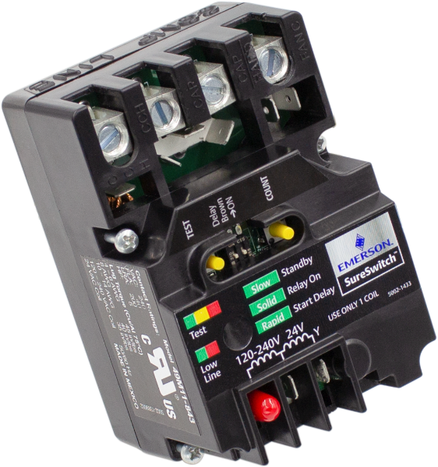
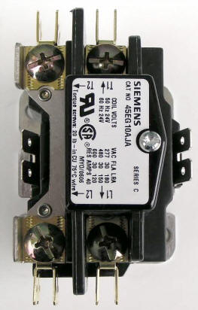
FAQ
SureSwitch™ wiring flexibility ensures fit in
greatest number of applications.
Replaces 1,1.5, or 2 pole contactors up to 40 FLA
Covers a Majority of OEM use on new units
Design functions the same as a
contactor with shunt on one leg.
Fan
SWITCHED
Comp Common
SWITCHED
Run L1
UNSWITCHED
Flexibility to mount sideways as needed
to avoid over manipulating wiring.
L2
SWITCHED

Slide 22
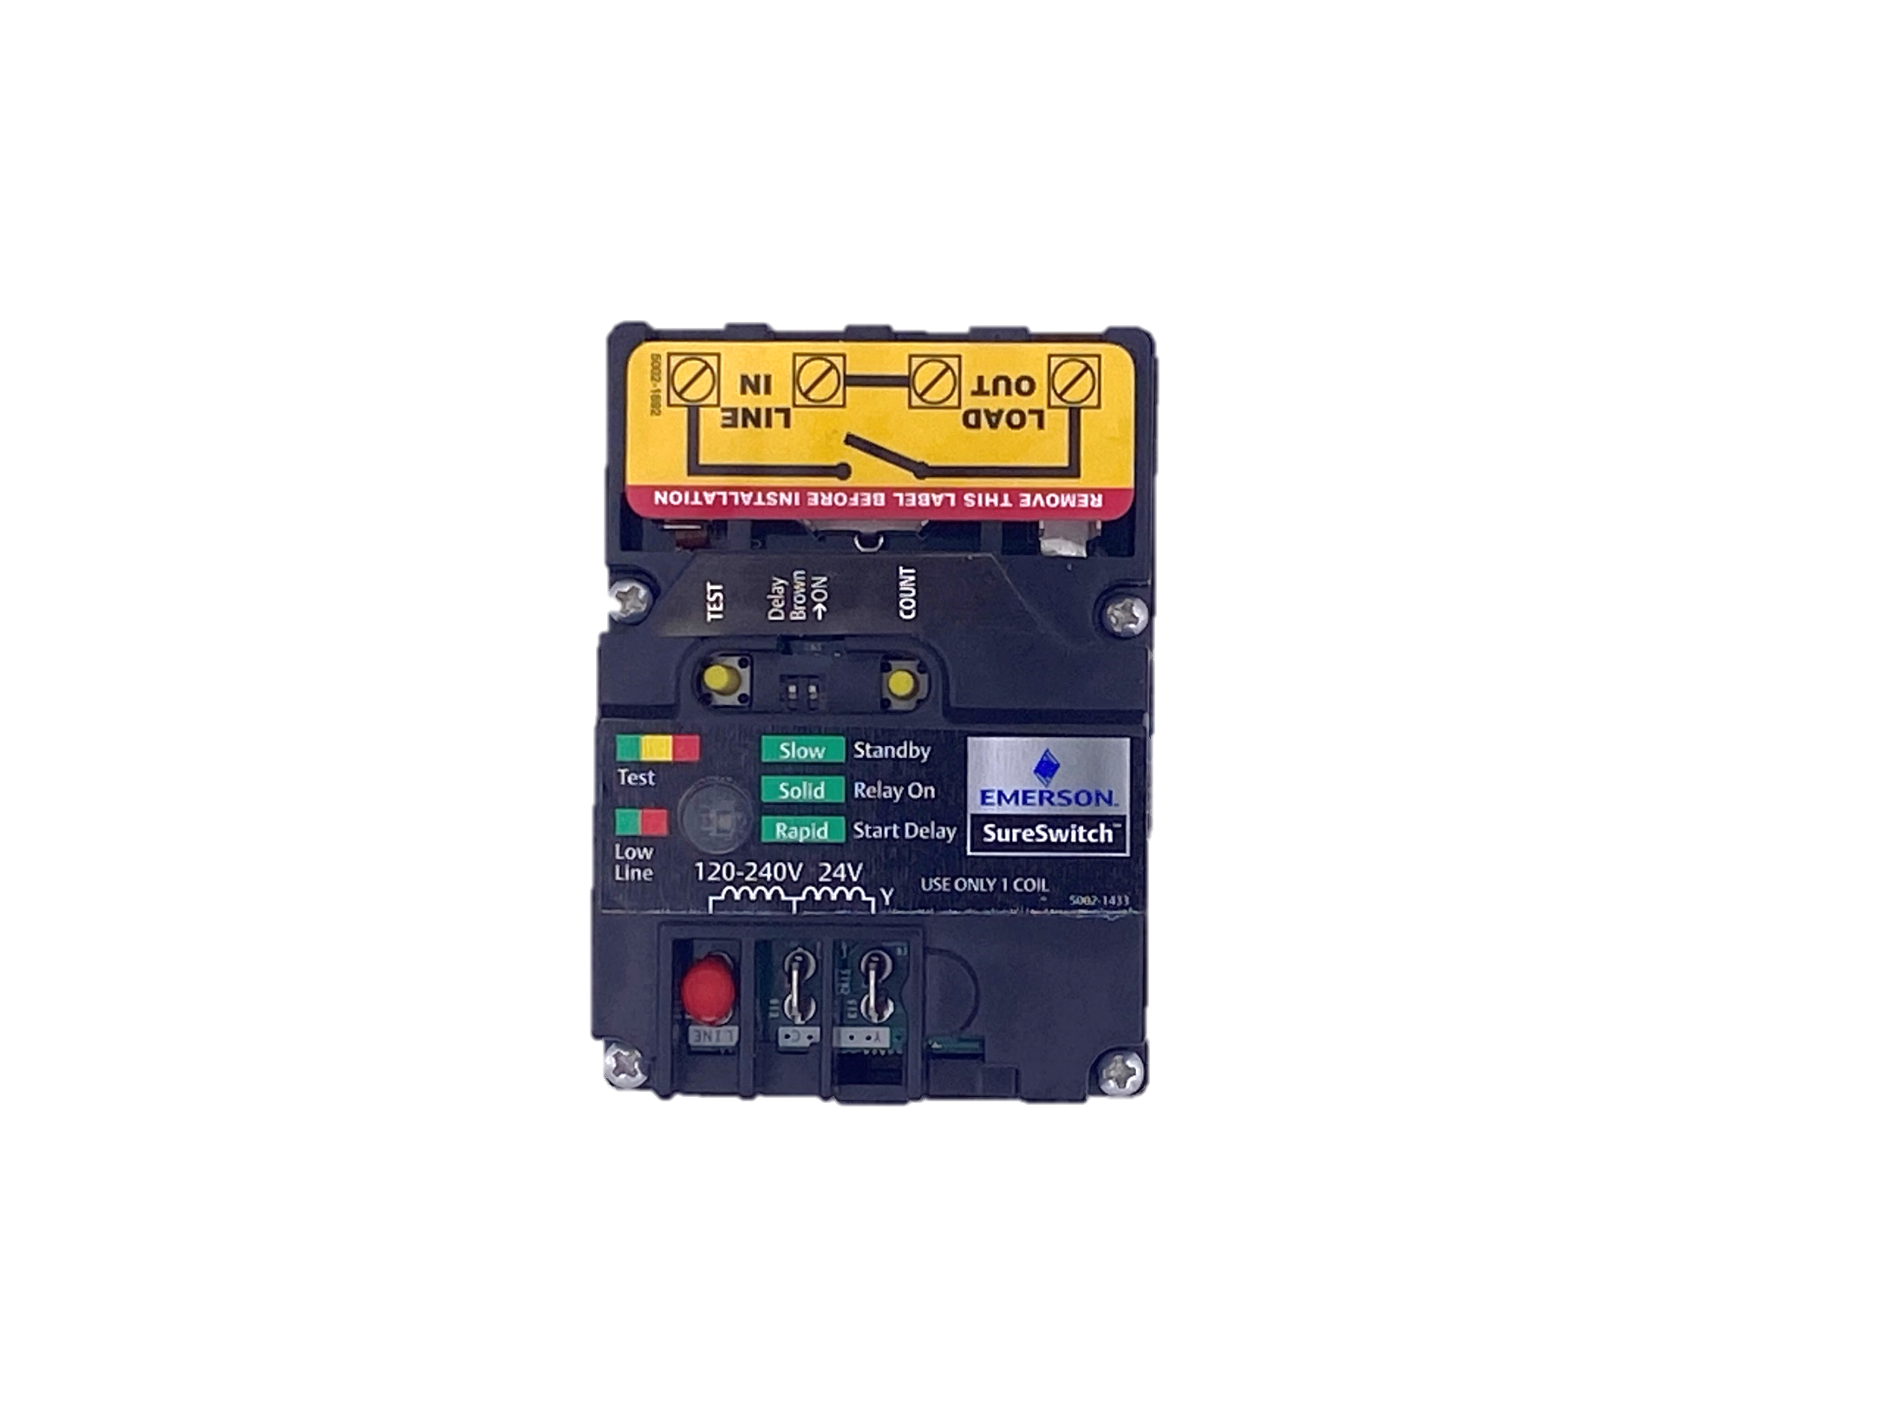
Coil Voltage Options
Applicable to 24v, 120v, 208v, or 240v coils, the SureSwitch is a reliable option for replacing refrigeration contactors. Determine the correct coil voltage by looking at the contactor being replaced.
SureSwitch comes with a red cap on one of the line voltage coil spade terminals. On line voltage applications, it can be moved to the 24V Y terminal.
The coil diagram shows how to connect line voltage or 24V coil wires. Only one coil should be connected
2
1

Slide 23
Refrigeration Wiring Considerations
In refrigeration equipment, it's best to review the schematic and determine the switched and common lines. Typically, the switched line is labeled "L1" or "Line" and the common line is labeled "L2" or "Neutral".
The "L1" or "Line" input wire should be connected to the switched "LINE IN" lug, and the corresponding wire for the compressor should be connected to the switched "LOAD OUT" lug.
The "L2" or "Neutral" input wire should be connected to the common "LINE IN" lug, and the corresponding wire for the compressor should be connected to the commone "LOAD OUT" lug.
For refrigeration applications, brownout and short cycle delay switches should be set to "OFF".
1
1
2

Slide 24
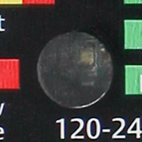
Tri-Color LED
Using the LED
The New LED indicator light has higher visibility to be seen easier in tighter installations
Press the “TEST” button for one second to energize the compressor and fan for five seconds to simulate a call for cooling.
The “TEST” button will also allow the short cycle time delay to be bypassed if a call for cooling is present, by pressing the “TEST” button for one second as well.
49M11-843

Slide 25

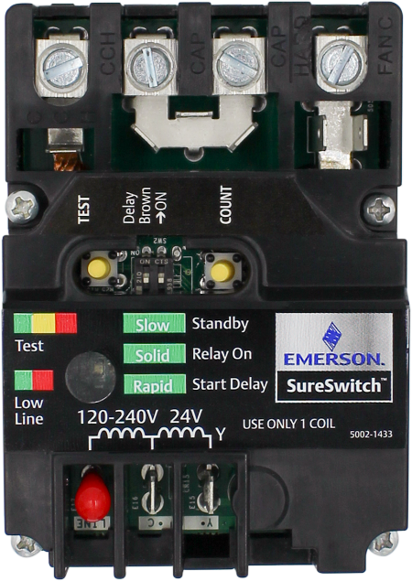
Comparison to Older / Competitive Products
1
1
Brownout Protection
Shuts off the compressor and fan if line voltage is below 180VAC for more than 4 seconds
  Fast-flashing Green/Red LED lets you know if voltage is low
Operation resumes if line voltage returns to a minimum of 190VAC
SureSwitch will not attempt to start the compressor and fan if line voltage is less than 187 VAC
  Fast-flashing Green/Red LED lets you know if voltage is low
SureSwitch ships with this feature turned on, but can be switched off by dipswitch
Brownout
Protection
Reduces chance for compressor and condenser fan motor damage; motor winding temps rise 10-15% for each 10% of voltage drop.
49M11-843

Slide 26

Comparison to Older / Competitive Products
2
2
Short Cycle Delay
SureSwitch starts a three-minute delay at power-up, and any time the compressor is shut down
  Fast-flashing green LED indicates a delay is present
SureSwitch ships with this feature turned on, but can be switched off by dipswitch
Short
Cycle Delay
Rapid cycling can pump out oil and do damage to compressors.
If system pressures aren’t allowed enough time to equalize, motor windings can be stressed.
1
2
+
Brownout
Protection
Short
Cycle Delay
49M11-843

Slide 27

Comparison to Older / Competitive Products
3
3
Random Start Delay
SureSwitch starts a 5-90 second delay, at power-up and recovery from a brownout.
  Fast-flashing Green LED indicates a delay is present
Normal compressor cycling will not activate a Random Start Delay
Random
Start Delay
Perfect for multi-unit installs like apartments to help reduce blackouts/brownouts from multiple loads restarting simultaneously.
1
2
3
+
+
=
Brownout
Protection
Short
Cycle Delay
Random
Start Delay
49M11-843

Slide 28
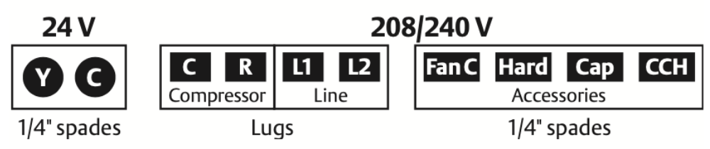
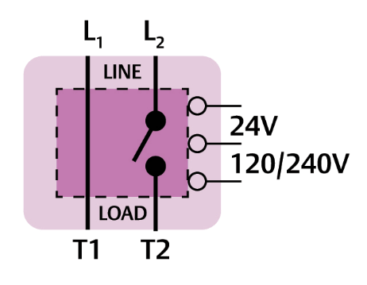

Specs
ELECTRICAL RATINGS
Line voltage input: 120/208/240 VAC, 1-phase, 50/60 Hz
Full load amperes: (FLA) 40A
Locked rotor amperes: (LRA) 200A
24 VAC Control (Coil) Voltage (Y,C): 24 VAC, 50/60 Hz
120/240 VAC Control (Coil) Voltage:
120/208/240 VAC, 1-phase, 50/60 Hz
For 2 Pole applications if local electrical codes are met
Operating Temperature Range
-40° to 158° F (-40° to 70°C)
Humidity Range
5 to 95% relative humidity (non-condensing)
Dimensions
2-3/4" W x 2-3/8" H x 3-7/8" L
Timings
Short-cycle delay: 0s or 180s (selectable) at 60 Hz 0s or 216s (selectable) at 50Hz
Compressor test: 5s at 60 Hz 6s at 60 Hz
Recommended Terminal
Torque – L1, L2, T2(R) and T1(C)
#4–6AWG: 45in-lbs
#8AWG: 40in-lbs
#10–14AWG: 35in-lbs
24 VAC (Y,C) terminals are ¼” male QC’s accepting #12-24AWG wire
Terminal Designations
SureSwitch requires line voltage for operation and testing.
Notes:
1-phase, 50/60 Hz

Slide 29
Install
49M11-843 SureSwitch™ Multi-Volt Contactor

Slide 30

Installing the SureSwitch Multi-Volt Contactor
The 49M11-843 SureSwitch™ Multi-Volt Contactor replaces 24v, 120v, 208v, or 240v coil contactors. And has wide compatibility with single stage residential AC/Heat pumps with PSC fan motors as well as refrigeration equipment such as walk-in coolers, refrigeration cases, ice machines, and carbonated beverage machines.
Today, we’ll walk through install steps for residential A/C or a heat pump.

Slide 31
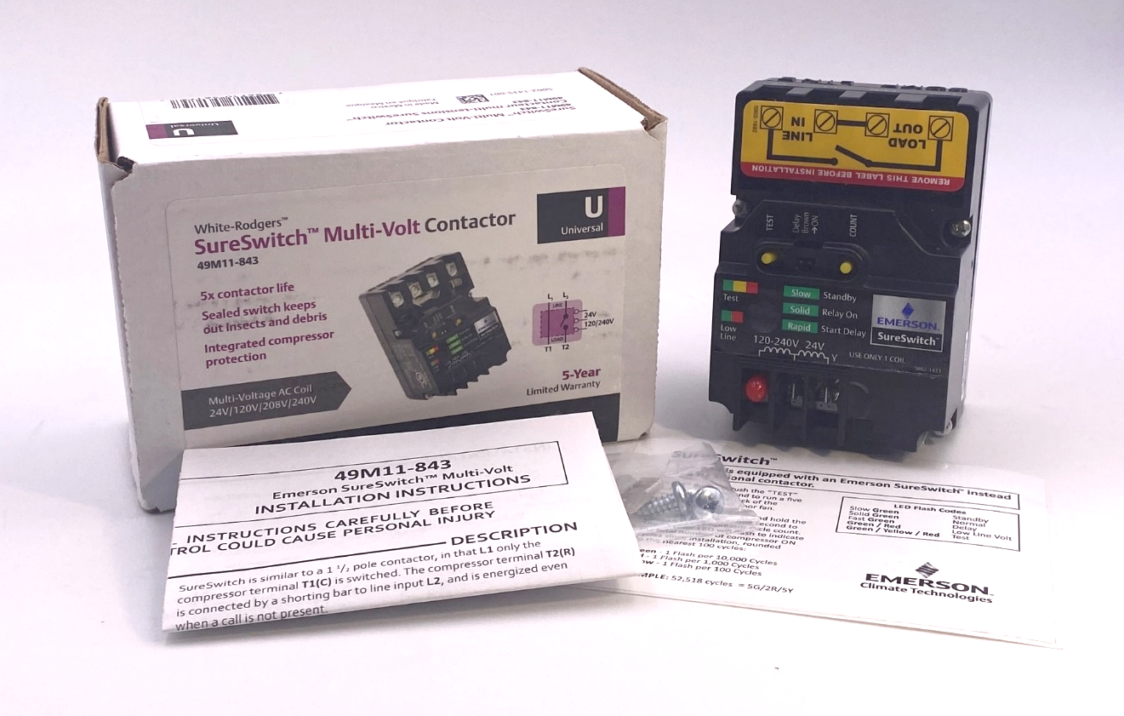
What’s in the Box
List of Contents:
SureSwitch™ Contactor
Instruction Sheet
Control Box Label
2x Mounting Screws
1x Dual Spade Splitter
SureSwitch™ Contactor Upgrade
UL Label

Slide 32
49M11-843 SureSwitch™ Multi-Volt Contactor Features
Features:
Line voltage Brownout Protection
Test Button to simulate a 5 sec “Y” call
Short Cycle Protection Delay Switch
  - Factory set to on (3 minutes)
Lifetime Cycle count Button
Brown Out Protection Switch
  - Factory set to on (180v >4sec.)
Tricolor LED Fault/Status Indicator
24v/120v/240v Coils
Random Start Delay following Brownout (5-90sec.) (Not Pictured)
Sealed Contacts (Not Pictured)
1
2
4
3
5
6
8
7
49M11-843

Slide 33
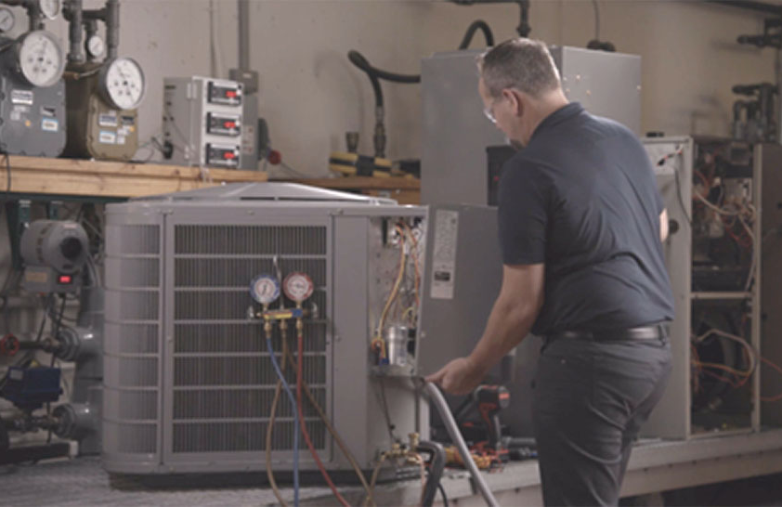
Installation – Step 1
1
Turn off the power to the condensing unit
Disconnect the power coming from the indoor unit
Remove the access panels

Slide 34
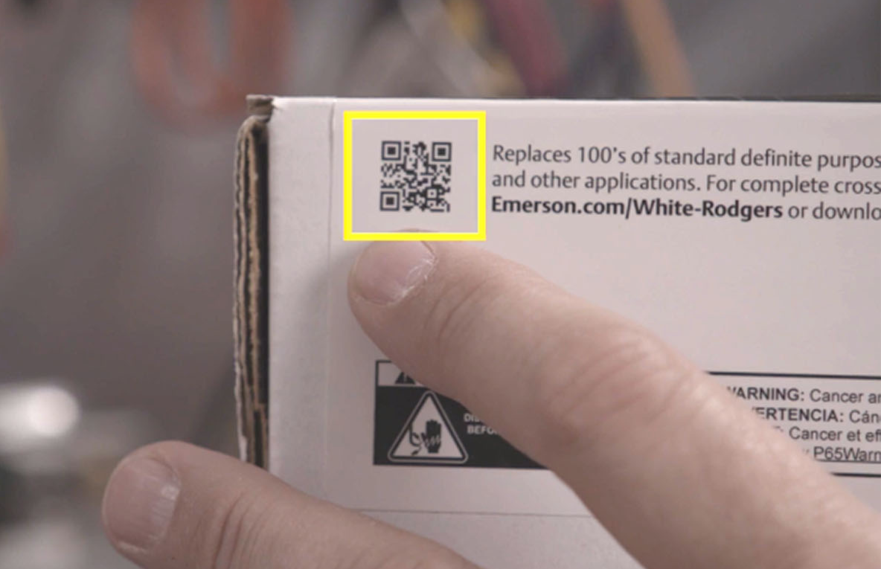
Installation – Step 2
2
Scan the QR on the package to download WR Mobile and check for the appropriate cross reference on the existing install.

Slide 35
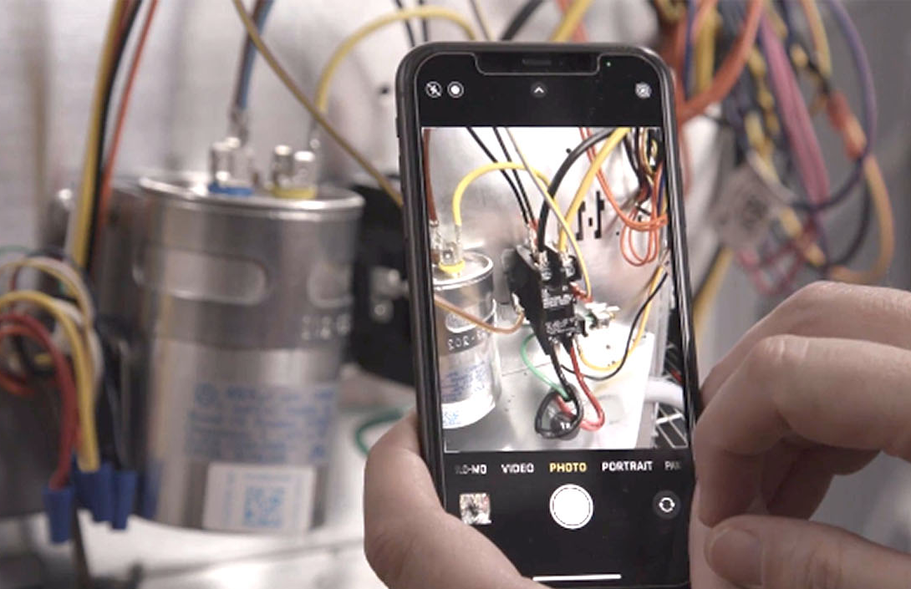
Installation – Step 3
3
Always a good idea to take a quick picture of the existing installation before disconnecting.

Slide 36
Installation – Step 4
4
Remove the Wiring:
Remove 24v coil wires
Disconnect line voltage
Verify circuit on shunt leg
Remove yellow and black wires from shunt and switch sides
Note the locations of the wires as you remove them, particularly the black wire with red tape connected to the line in switched side.
Remove the contactor

Slide 37
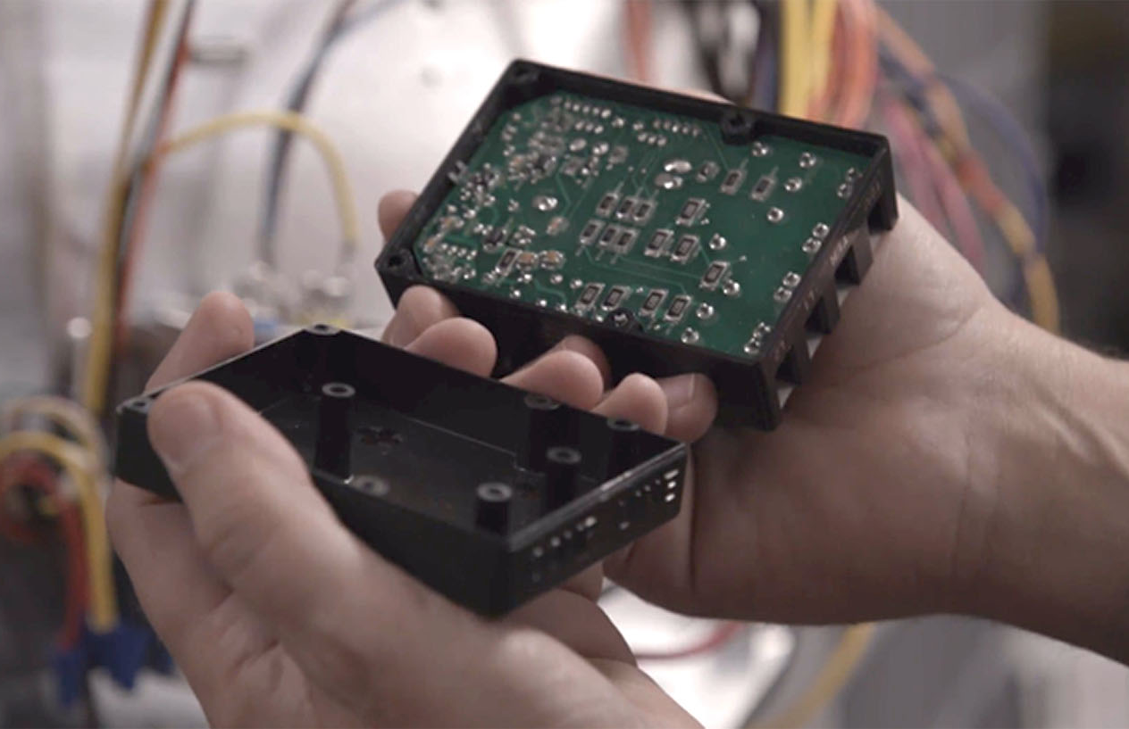
Installation – Step 5
5
Select flat mounting location and then separate the housing, noting the base orientation before separating. You'll note that three screws are loose, and one is tightened when it comes from the factory.

Slide 38
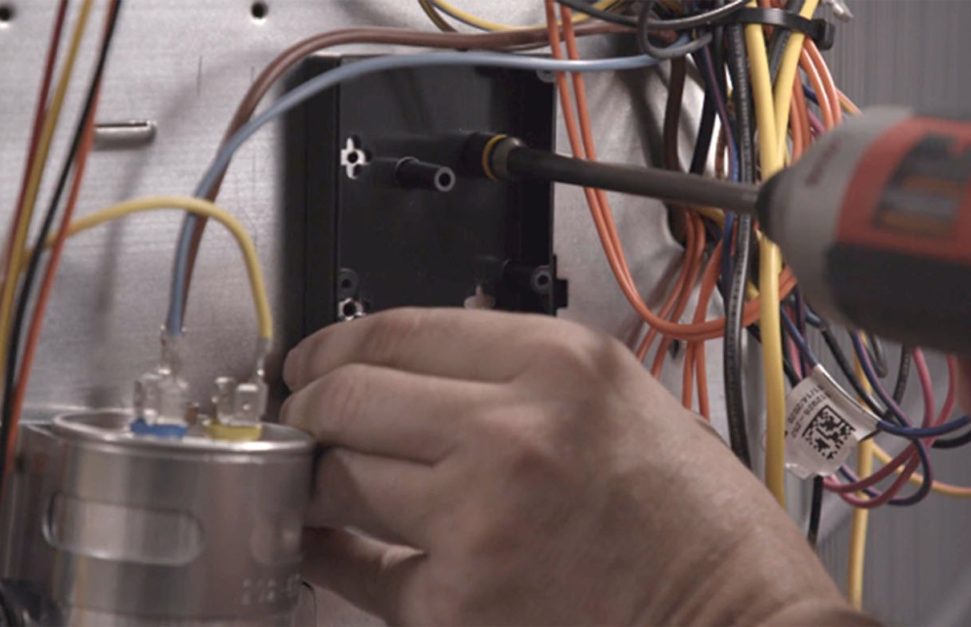
Installation – Step 6
6
Attach mounting base to the control panel and then reattach the SureSwitch™ to the base with 4 included screws.

Slide 39
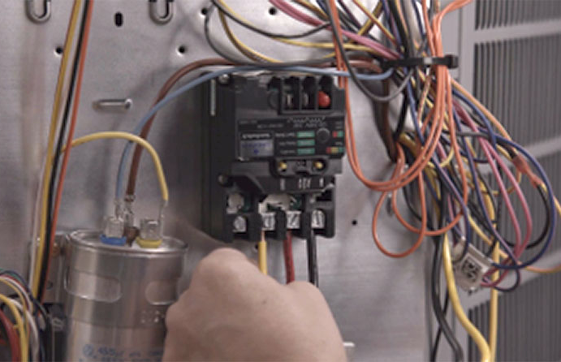
Installation – Step 7
7
Connect the wiring:
Remove label over contacts before beginning
Attach line voltage to L1 and L2, torque to spec
Install common and run wires, removing connectors if necessary, to T1 and T2, torque to spec
  Yellow is T1 / Black is T2
  Install remaining yellow wires to T1 shunt leg
Attach black wire with red tape to L2
  Install remaining black wires to T2
Based on application, utilize spade terminals
  (Here, 24v wires to Y and C, red cap stays on line spade terminal)

Slide 40
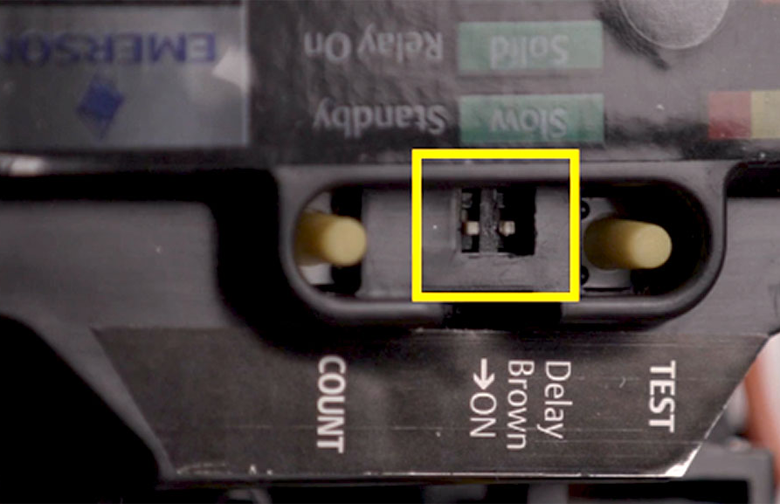
Installation – Step 8
8
For short cycle time delay and brownout protection, dipswitches are factory set to “on”. If desired, disable with a small screwdriver.

Slide 41
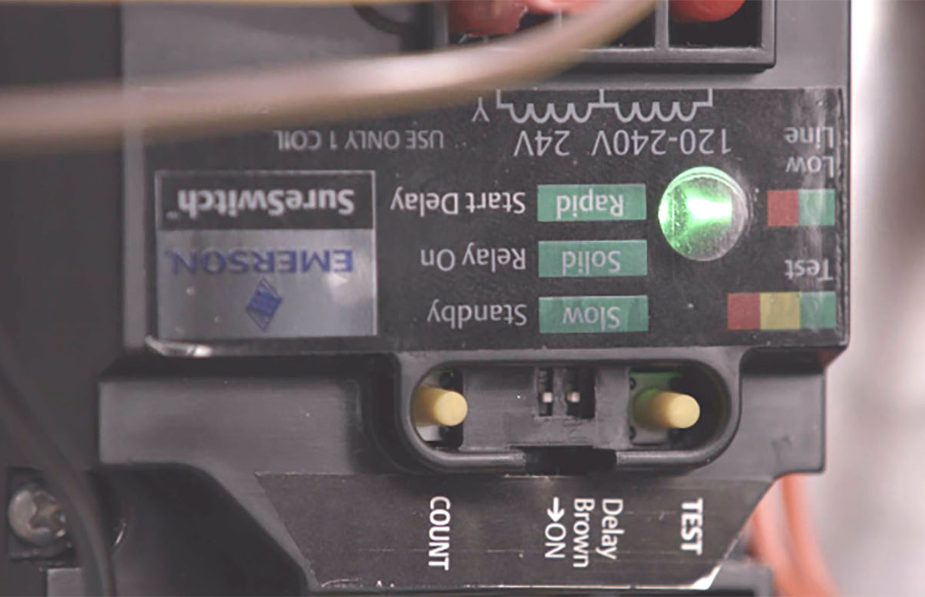
Installation – Step 9
9
Test your work:
Turn on the power to the condensing unit
Turn on the low voltage from the indoor unit
  Green LED will flash slow indicating stand-by mode

Slide 42

Installation – Step 10
10
Test your work:
Press the test button for one second to enter self-test mode.
Initiate a call for cooling
  Rapid Green LED flash = short cycle delay
Bypass short cycle delay by pressing Test for 1 second
  Solid Green LED = normal operation
Terminate call for cooling

Slide 43

Installation – Step 11
11
Lifetime Cycle Count
Press the count button for one second to view the total number of compressor cycles.
If desired, reset the cycle count by pressing Test and Count for 2 seconds. LED will flash red and yellow.

Slide 44

Installation – Step 12
12
Apply the control label inside the control box, reattach the access panel and you’re good to go.

Slide 45
Thank You
49M11-843 SureSwitch™ Multi-Volt Contactor

